Slide 1
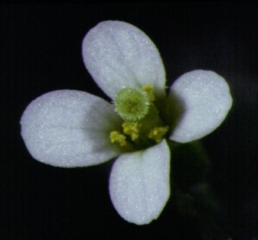
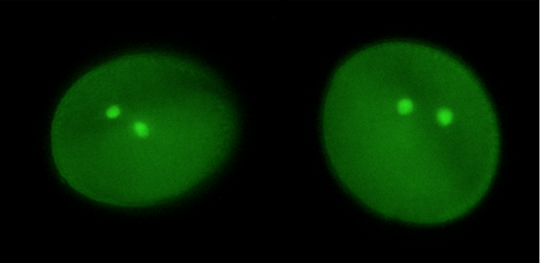


The plant retrovirome and its regulation by small RNA.
CSHL Advanced Sequencing Course
November 15th 2022

Slide 2
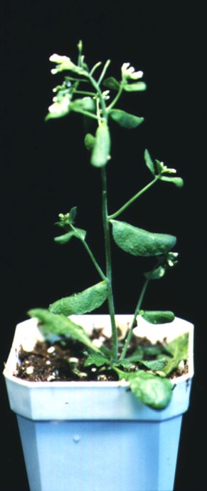
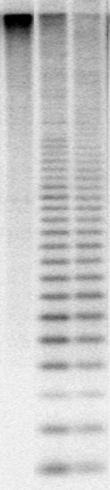
DDM1 and MET1 maintain DNA methylation in plants (and mammals)
DDM1 (decrease in DNA methylation1) encodes a SWI2/SNF2 ATPase (Lsh1)
MET1 (ddm2) encodes DNA methyltransferase (Dnmt1)
Both strongly effect expression of retrotransposons (endogenous retro-viruses)
ddm1
WT
met1

Slide 3
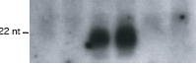
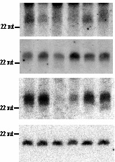
21nt “epigenetically activated” easiRNA accumulate in met1 and ddm1
cmt3
met1
ddm1
kyp
sil1
+
21nt
easiRNA
Athila (LTR Gypsy)
AtMu1 (DNA transposon)
AtGP1 (LTR Gypsy)
24nt siRNA
AtSN1 (SINE)
miR171

Slide 4
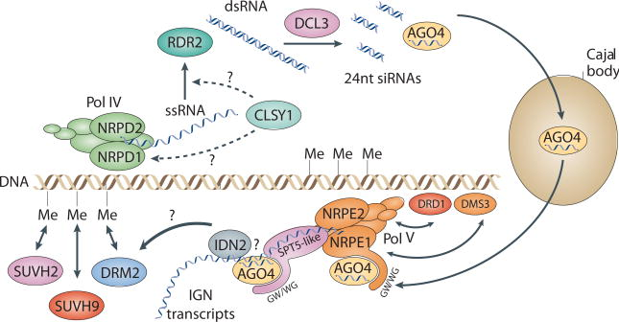
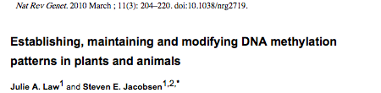
24nt small RNA guides CHH methylation to plant transposons

Slide 5
miRNA triggers secondary siRNA biogenesis in plants
Borges and Martienssen, NRMCB, 2016

Slide 6
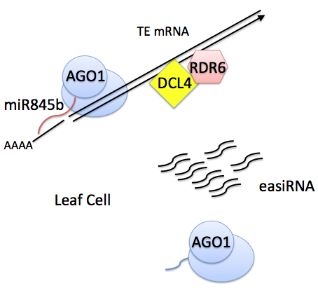

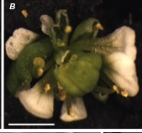
21nt easiRNA biogenesis is triggered by miRNA and is required for fertility
ddm1
ddm1 rdr6
Creasey et al., Nature 2014
Keith Slotkin

Slide 7
easiRNA inhibit Copia RNA accumulation (RNAi)

Slide 8
Virus-like particle (VLP) sequencing of retrotransposition intermediates
Plus strand
intermediates

Slide 9
Nanopore VLP sequencing of retrotransposition intermediates
Virus like particles (VLP) purified from ddm1 and ddm1rdr6
dsDNA subjected to long-read Oxford Nanopore sequencing
ddm1
ddm1 rdr6
Seung Cho Lee, Evan Ernst

Slide 10
COPIA52 preferentially forms autointegration circles
Seung Cho Lee, Evan Ernst

Slide 11
COPIA52 preferentially forms autointegration circles
VLP dsDNA sequenced by paired end Illumina short reads
reveals non-concordant read orientations (autointegration circles)
Lee, Ernst et al Genome research 2020

Slide 12
Retrotransposon autointegration

Slide 13
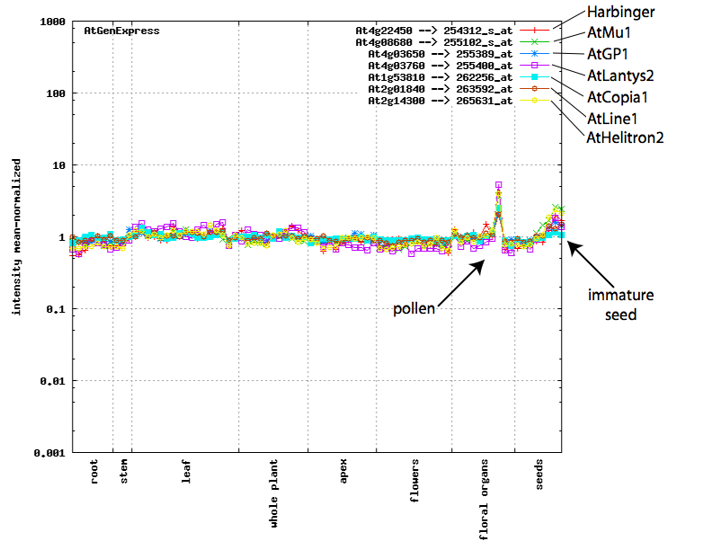
Transposons are expressed in wild-type pollen
Microarray
expression
profiles
Keith Slotkin

Slide 14

Germline reprogramming in plants
Filipe Borges

Slide 15
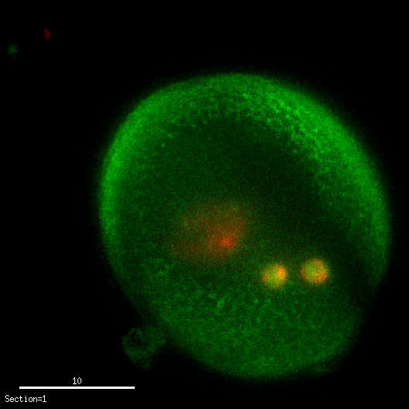
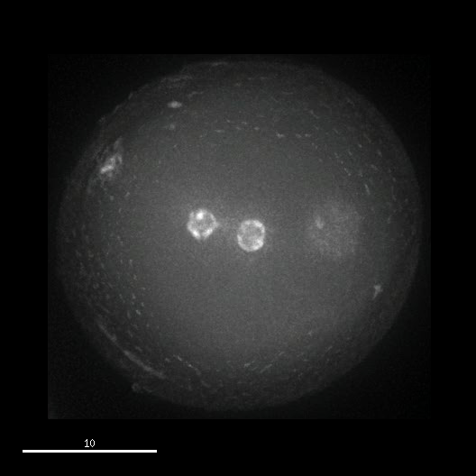
DDM1 is expressed in sperm cells, but not in the vegetative nucleus
DNA
DDM1-GFP
DNA
Sperm cells
Vegetative
nucleus
Slotkin et al., Cell 2009

Slide 16
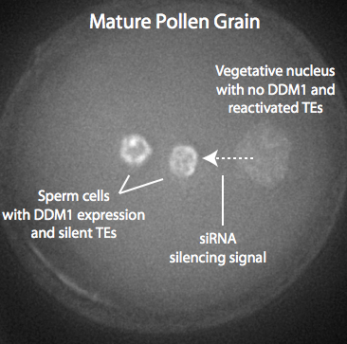
Small RNA generated in pollen accumulates in sperm cells
Slotkin et al., Cell 2009

Slide 17
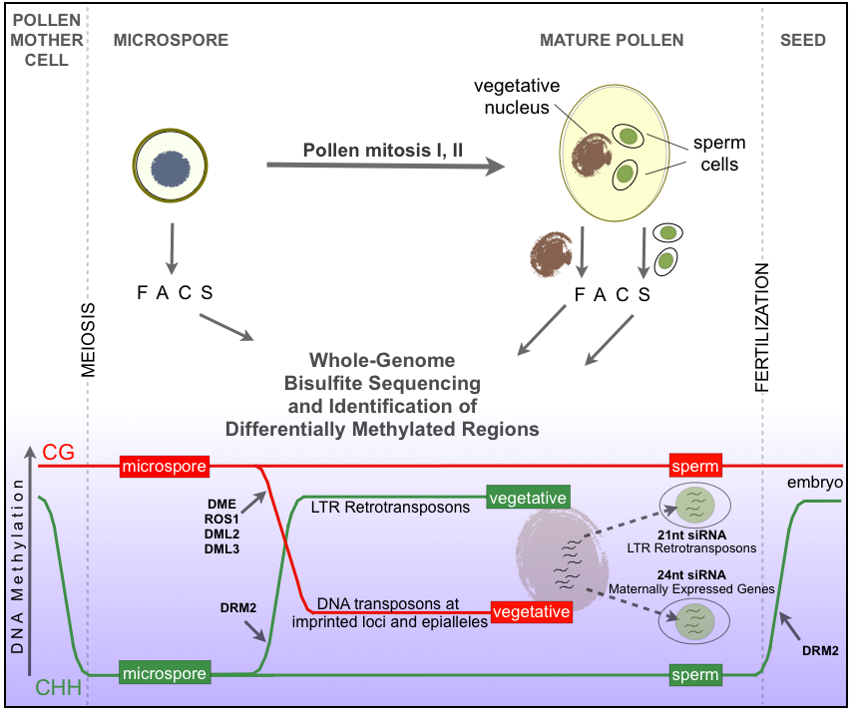
Calarco et al., Cell 2012

Slide 18
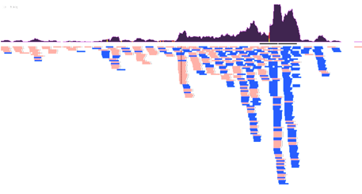
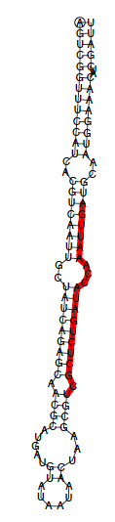
miR845 is very abundant in pollen and triggers easiRNA
21/22-nt siRNA
sense
antisense
Filipe Borges

Slide 19
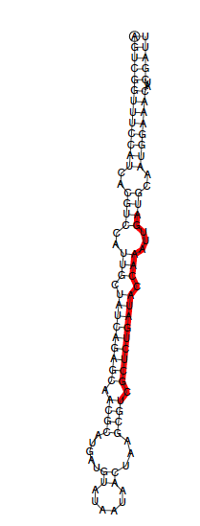
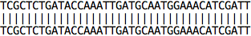
MIR845b polymorphism blocks processing in some strains of Arabidopsis (Landsberg erecta)
Col-0
ath-miR845b
Ler-0
ath-miR845b
*
*
Col-0
1
99
Ler-0
1
99
Filipe Borges

Slide 20
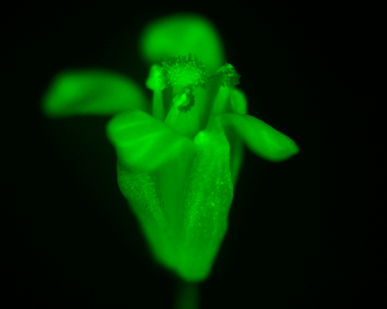
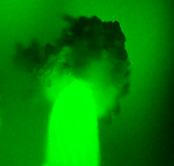

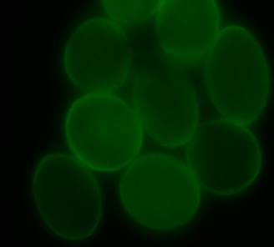
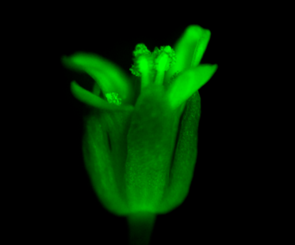
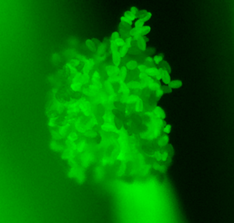
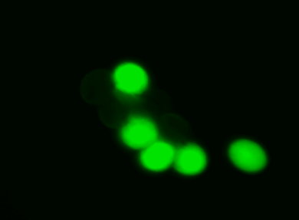
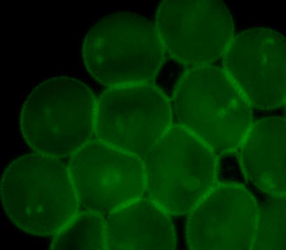
miR845 activity in Columbia (Col) but not Landsberg (Ler) pollen
UBQ10p::GFP-miR845b
MGH3p::GFP-miR845b
Col
Ler
GFP
GFP
T
miR845b
target site
Filipe Borges

Slide 21
PBS (primer binding site) of LTR retrotransposons is targeted by miR845 in pollen
Filipe Borges

Slide 22
PBS (primer binding site) of LTR retrotransposons is targeted by miR845 in pollen
Almost all COPIA and GYSPY retrotransposons use tRNA^{iMet} primer in Arabidopsis
PBS are invariable providing uniquely sensitive targets
In mouse, PBS of ERV are targeted by 3’tRF (tRNA fragments)

Slide 23
PBS (primer binding site) of LTR retrotransposons is targeted by miR845 in pollen

Slide 24
PBS (primer binding site) of LTR retrotransposons is targeted by miR845 in pollen
Filipe Borges

Slide 25
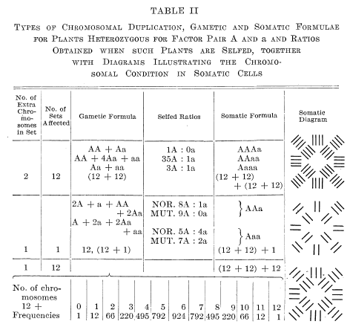

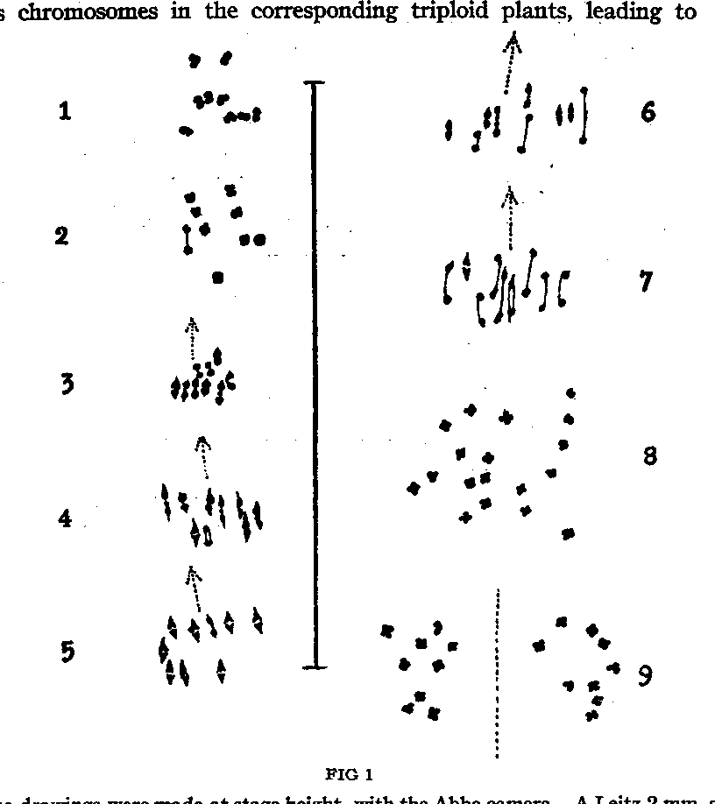
Albert Blaskeslee and the triploid block
CSHL
1921

Slide 26
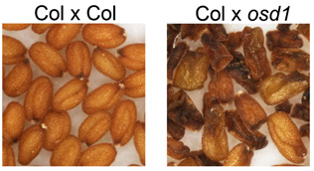
Lansdberg is defective in the “triploid block”: dose-dependent lethality
Intraspecific polyploidy common in plants, but triploid meiosis strongly detrimental
In most flowering plants, triploid seeds collapse due to imprinting defects (“endosperm balance”)
osd1 mutants have diploid pollen, and osd1 seed collapse in Columbia, but not in Landsberg.
Martienssen, New Phytol. 2010
Collaboration with Claudia Kohler

Slide 27
miR845b mutants relax the triploid block
miRNA abundance
Seed viability
Filipe Borges, Jean-Sebastien Parent
Collaboration with Claudia Kohler

Slide 28
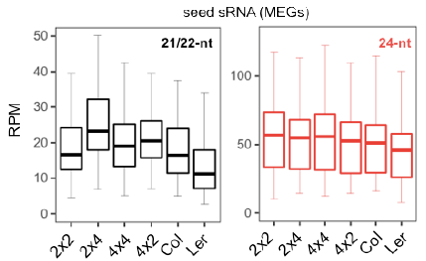
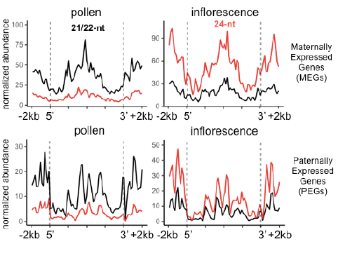
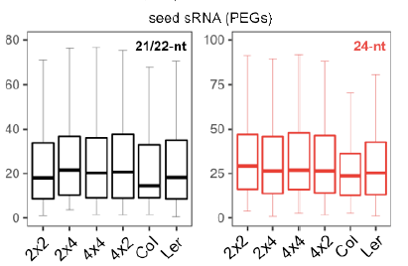
easiRNAs from pollen target imprinted genes in seeds
Borges et al., Nature Genetics, 2018

Slide 29
Summary (Part I)
Reprogramming activates transposons in plant and animal germlines
Retrotransposon tRNA primer binding site (PBS) is targeted by miR845 in pollen (and tRNA fragments in mouse) that triggers easiRNA in sperm
easiRNA control retrotransposons in DNA methylation mutants via RNAi and histone H3K9me2
easiRNA in sperm are required for the triploid block (dosage response) in the seed

Slide 30
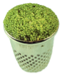
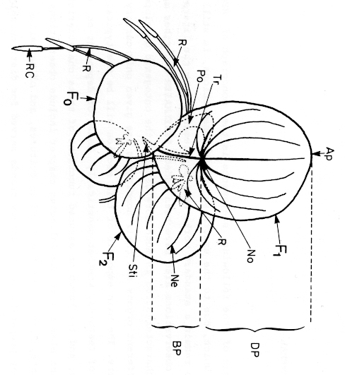
Duckweeds (Lemnaceae): clonal reproduction without meiosis
Liopsida | class
Aridae | subclass
Arales | order
Araceae | family
Wolfia microscopica
Reduced morphology
Fronds (leaf-like structures)
Meristem-like stem cell “pocket”
Clonal reproduction
12-48 hours duplication by budding
Limited flowering
10cm² to 1 hectare in 50 days
Spirodela polyrhiza
(Landolt, 1986)

Slide 31
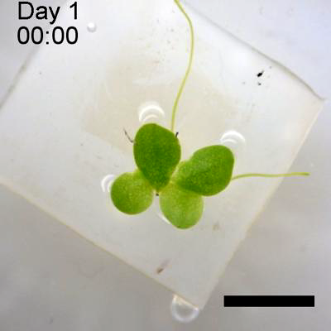
Growing duckweed (Lemna gibba)
in constant light conditions
10 mm
Notes:
And this is what I am using as a material of my research. Do you see any rhythmicity in this growth?
Actually duckweed does not show rhythmic growth. However, this does not mean duckweed does not have circadian rhythms.

Slide 32
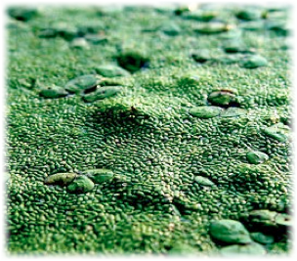
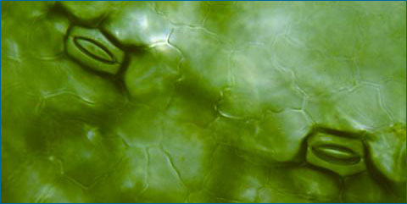
Lemnaceae as an climate crop
Duckweeds can reproduce clonally by budding without meiosis
Excellent metabolic profile:
Growth rate (12-48h doubling time)
Starch 12-50%
Protein 11-40%
Lipid 2-9%
Low lignin content (5%)
Open stomata, unlimited access to gaseous CO₂.

Slide 33
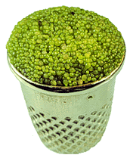
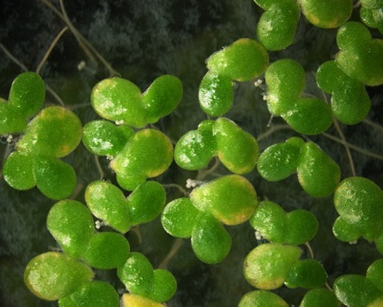
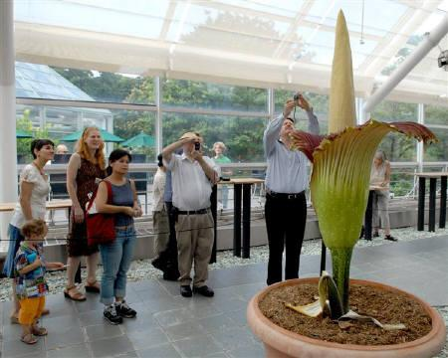
The Duckweeds
Liliopsida
Aridae
Arales
Araceae
class
subclass
order
family
Lemna | Landoltia | Spirodela | Wolffia | Wolffiella
aequinoctialis | punctata | intermedia | angusta | caudata
disperma |  | polyrhiza | arrhiza | denticulata
gibba |  |  | australiana | gladiata
japonica |  |  | borealis | hyalina
minor |  |  | brasilensis | lingulata
minuta |  |  | columbiana | neotropica
obscura |  |  | cylindracea | oblonga
perpusilla |  |  | elongata | repanda
tenera |  |  | globosa | rotunda
trisulca |  |  | microscopica | weltwischii
turionifera |  |  | neglecta
valdiviana
yungensis
Notes:
Early branching Araceae

Slide 34

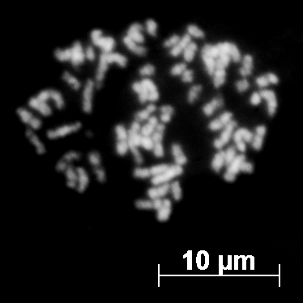
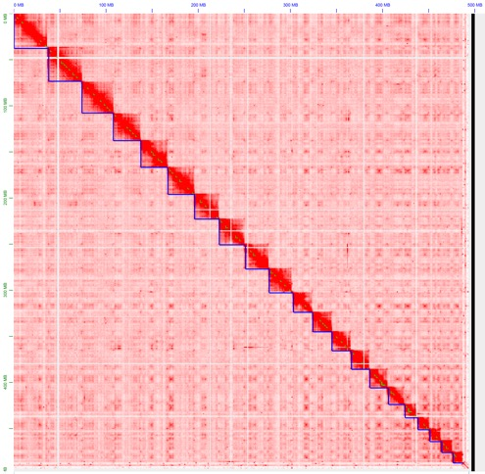
Deciphering Duckweed Genomes
L. gibba 7742a
L. japonica 8627
S. polyrhiza 9509
W. Australiana 8730
Evan Ernst, Todd Michael, Eric Lam

Slide 35
Assembly Overview (new school)
Adapter trimming
porechop
Quality filtering
catseq
Read error correction
Masurca (polyploid?)
Assembly
Flye (diploid)
Polishing
2 x racon ONT
1 x medaka
1 x racon Illumina
Hi-C Scaffolding
3D-DNA

Slide 36
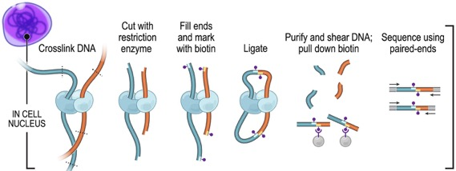
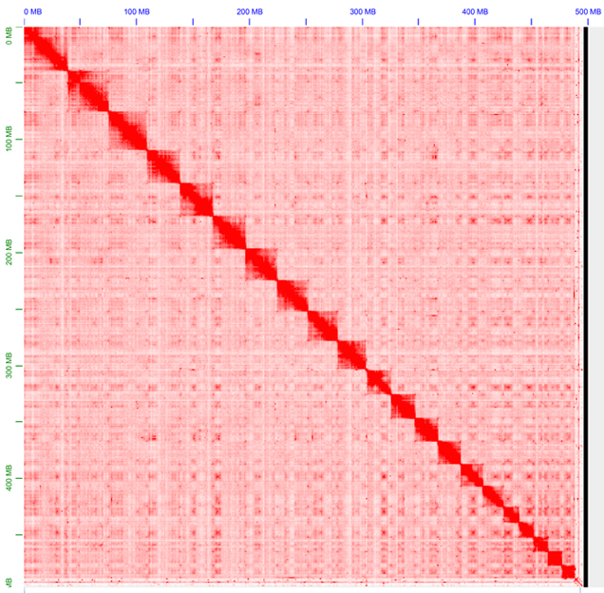
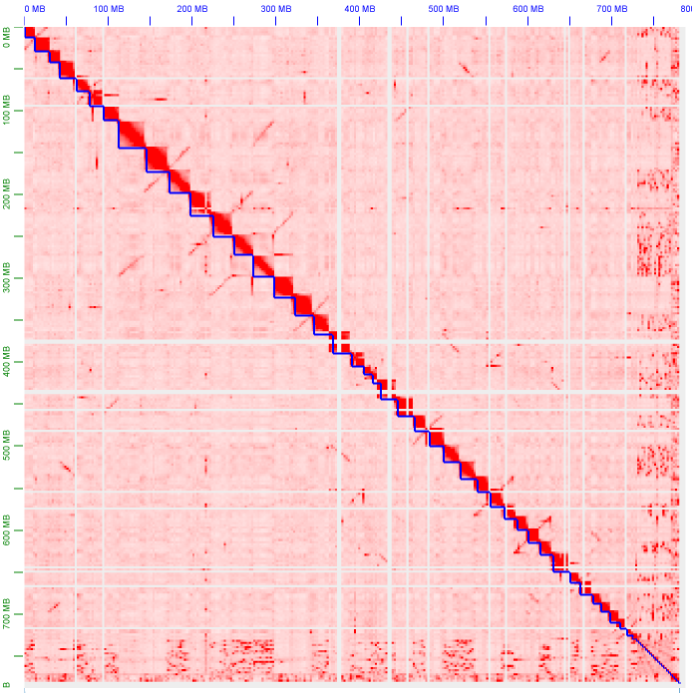
Hi-C Libraries order and orient long contigs into chromosomes
L. gibba 7742a
21 pseudomolecules
L. japonica 8627
42 pseudomolecules
Library prep: Dovetail Genomics Mapping and scaffolding: Juicebox
Notes:
Explain each metric.

Slide 37


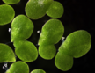
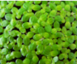
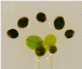
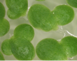
Lemnaceae genome project
X
 | S. polyrhiza greater duckweed Sp9509 v3 JCVI | W. australiana Australian watermeal Wa8730 v3 CSHL | L. gibba swollen duckweed Lg7742a v3 CSHL | L. minor lesser duckweed Lm9252 v1 CSHL | L. minor lesser duckweed Lm7210 v1 CSHL | L. turionifera turion duckweed Lt9434 v1 CSHL | L. japonica L. min. x L. tur. (3n = MMT) Lj8627 v3 CSHL | L. japonica L. min. x L. tur. (3n = TTM) Lj7182 v1 CSHL | L. japonica L. min. x L. tur. (3n = TTM) Lj9241 v1 CSHL
Genomes
span (Mbp) | 139 | 355 | 491 | 354 | 363 | 410 | 772 | 764 | 771
Repeats
all interspersed (%) ^{A} | 12 | 48 | 71 | 57 | 59 | 61 | 62 | 62 | 63
LTR-RT (%) ^{A} | 7 | 23 | 57 | 43 | 42 | 43 | 43 | 44 | 42
intact LTR-RT/Mpb (#) ^{A} | 0.1 | 0.6 | 2.0 | 1.2 | 1.7 | 1.3 | 1.3 | 1.3 | 1.6
LTR solo:intact ratio ^{A} | 12 | 15 | 47 | 64 | 58 | 61 | 64 | 62 | 63
Protein coding genes
Mikado genes ^{B} | 16,827 | 13,095 | 18,427 | 17,138 | 16,701 | 16,613 | 31,990 | 31,761 | 31,746
GeMoMa genes ^{C} | 20,389 | 22,416 | 24,717 | 22,754 | 22,362 | 22,862 | 40,651 | 40,523 | 40,203
Augustus CGP genes ^{D} | 17,841 | 13,175 | 17,734 | 20,697 | 20,838 | 18,325 | 37,544 | 38,104 | 38,451
Combined & filtered ^{E,F,G} | 20,382 | 20,902 | 24,257 | 22,247 | 21,683 | 22,019 | 40,747 | 40,504 | 40,388
PASA Updated ^{H} | 20,342 | 20,882 | 24,222 | 22,205 | 21,649 | 21,988 | 40,692 | 40,444 | 40,336
Non-coding gene loci
transcribed ncRNA ^{B} | 647 | 865 | 1,852 | 1,252 | 888 | 976 | 2,100 | 2,095 | 2,107
snoRNA/snRNA ^{I} | 541 | 864 | 1,141 | 751 | 785 | 1,210 | 2,017 | 2,016 | 2,286
tRNA ^{I} | 237 | 623 | 470 | 253 | 260 | 278 | 486 | 482 | 479
miRNA loci ^{J} | 59 | 65 | 74 | - | - | - | 108 | - | -
(A) EDTA/LTR_retriever | (B) Mikado | (C) GeMoMa | (D) Augustus | (E) AGAT | (F) MAKER-P | (G) TEsorter | (H) PASA | (I) Infernal | (J) ShortStack
Evan Ernst (collaboration between Martienssen, Michael and Lam labs)

Slide 38
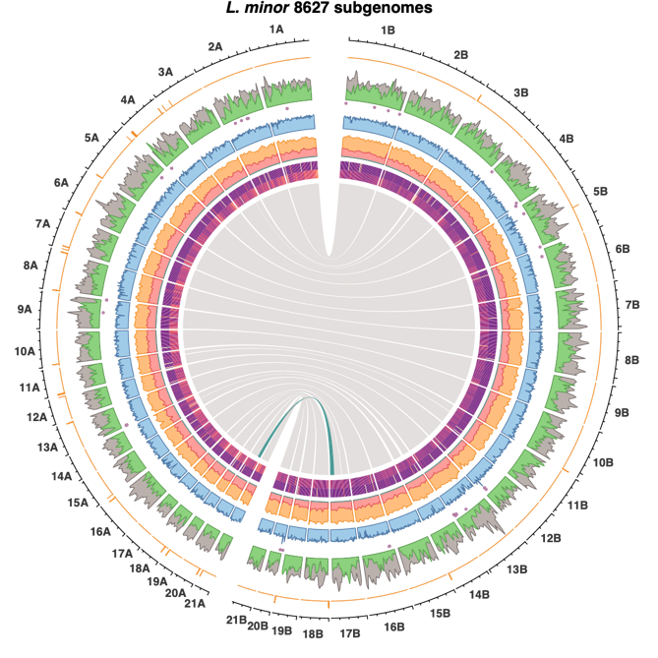
L. japonica are triploid hybrids
(L. minor x L. turionifera)
Lemna japonica 8627
| | Telomere repeat (6x)
 | Repeats
 | Coding genes
• | rDNA
 | RNA-seq
 | 5mC CpG
 | 5mC CHG
 | 5mC CHH
 | 21-22nt small RNA
 | 24nt small RNA
Nanopore long-read sequencing with full-length chromosome scaffolding by Hi-C gives two full chromosome sets for the clone labeled L. minor 8627
gDNA read coverage indicates a 2x/1x ratio – a triploid signature
AFLP confirm the existence of widespread interspecific L. minor x turionifera hybrids and the L. japonica identity of 8627 (Braglia et al. (Frontiers in Plant Science, 2021)
Whole-genome sequencing of additional L. japonica, L. minor and L. turionifera accessions revealed that triploid formation occurs in both directions.
Evan Ernst
Homeologous chromosomes of L. japonica 8627. Central ribbons show synteny. A single large-scale translocation between L. minor and L. turionifera subgenomes is highlighted in teal.

Slide 39


Phylogenomic analysis
Unique to all Lemnaceae
Orthogroups in intersection
Missing from all Lemnaceae
Evan Ernst

Slide 40


GO Term Enrichment: Floating aquatic plants
Unique orthogroups
Missing conserved orthogroups
area ~ -log10(p-value) of enrichment

Slide 41

Gene silencing in Lemnaceae: missing orthogroups and genes
Missing orthogroups (36)
Evan Ernst

Slide 42
Gene silencing in Lemnaceae: missing orthogroups and genes
Missing orthogroups (36)
Missing HOGs
GO:0031047 gene silencing by RNA
CLY1/2
DCL2
IDM1(ROS4)
RTL1/2/3
GO:0009615 response to virus
AGO2/3
Missing genes
AGO6
CMT2
DRM3
MORC1/2/3 [Lemna & Wolffia]
MORC6 [Lemna & Wolffia]
SHH1
Evan Ernst

Slide 43
Gene silencing in Lemnaceae: missing orthogroups and genes
Missing HOGs
GO:0031047 gene silencing by RNA
CLSY1/2
DCL2
IDM1(ROS4)
RTL1/2/3
GO:0009615 response to virus
AGO2/3
Lemnaceae have one de novo DNA methyltransferase (DRM2) capable of asymmetric CHH methylation (RNA directed DNA methylation)
But they have lost CMT2 (as has maize, but not rice) which is the main CHH methyltransferase
All Lemnaceae have retained DCL3 (required for 24nt siRNA)
But they have lost AGO 2/3/6 and DCL2 (required for some 21/22nt siRNA)
Missing genes
AGO6
CMT2
DRM3
MORC1/2/3 [Lemna & Wolffia]
MORC6 [Lemna & Wolffia]
SHH1
Evan Ernst

Slide 44

Gene silencing in Lemnaceae: small RNA from fronds
Missing HOGs
GO:0031047 gene silencing by RNA
CLSY1/2
DCL2
IDM1(ROS4)
RTL1/2/3
GO:0009615 response to virus
AGO2/3
Missing genes
AGO6
CMT2
DRM3
MORC1/2/3 [Lemna & Wolffia]
MORC6 [Lemna & Wolffia]
SHH1
Evan Ernst

Slide 45
Lemnaceae have very low asymmetric (CHH) DNA methylation

Slide 46




Loss of fertility is accompanied by loss of transposons (and methylation)
L. minor
S.polyrhiza
L. gibba
W. australiana
Notes:
Early branching Araceae

Slide 47
Reproductive strategy and transposon evolution
Genetica. 1992;86(1-3):269-74.
Evolutionary dynamics of transposable elements in prokaryotes and eukaryotes.
Hickey DA¹.
Author information
1Department of Biology, University of Ottawa, Ontario, Canada.
Abstract
This paper summarizes some recent theories about the evolution of transposable genetic elements in outbreeding, sexual eukaryotic organisms. The evolutionary possibilities available to self-replicating transposable elements are shown to vary depending on the reproductive biology of the host genome. This effect can be used to explain, in part, the differences in abundance of transposable elements between prokaryotes and eukaryotes. It is argued that the pattern of sexual outbreeding seen in mammals and plants is especially favorable to the spread of transposons. Moreover, because transposon spread is facilitated by zygote formation, the evolutionary origin of sexual conjugation may have been due to selection on transposon-encoded genes. Finally, evidence is also presented that introns could have originated as transposable genetic elements.

Slide 48



Synthetic Biology tools for engineering Lemna
Rapid and efficient agrobacterium transformation of clonal fronds (Cantó-Pastor et al., Plant Biol 2014)
Artificial miRNA for dominant gene knock down (Cantó-Pastor et al., Plant Biol 2014)
CRISPR/Cas9 homozygous loss of function (Liu et al., Plant Biotech., 2019)
Transgene stacking systems
Under development:
CRISPRi and CRISPRa libraries
artificial chromosomes
Evan Ernst, Alex Canto Pastor, Almudena Molla Morales (collaboration between Martienssen, Shanklin and Birchler labs)

Slide 49
Summary (Part II)
Lemnaceae genomes have been sequenced to very high accuracy and contiguity (ONT, Illumina and hi-C technology)
Gene content is 50-60% of other angiosperms, reflecting extreme reduction in morphological and physiological complexity
Sterile polyploid interspecific hybrids are common, in part due to the loss of gene silencing and the triploid block
Key developmental traits (eg. reduced roots and flowers) and physiological traits (eg. Stomatal opening in high CO2) are associated with evolutionary loss and divergence of regulatory genes
Genome-guided development of a synthetic biology toolkit enables pathway engineering

Slide 50

Former lab members:
Filipe Borges
Rowan Herridge
Jean-Sebastien Parent
Jakub Dolata
Atsushi Shimada
Current Lab members
Cris deSantis Alves
Seung-Cho Lee
Florencia Campatella
Jon Cahn
Ben Berube
Evan Ernst
Cristian Mateo Elizalde
Joe Simorowski
Uma Ramu
Mike Regulski
Liam Spielmann
Collaborators
Dick McCombie
Jerry Kermicle
Daniel Grimanelli
Claudia Köhler
Blake Meyers
Leemor Joshua-Tor
Benjamin Roche
Hyun-Soo Kim
Teri Cheng
Josh Steinberg

Slide 51


Acknowledgements
Martienssen Lab
Rob Martienssen
Will Dahl
Ramu Umamaheswari
Joe Simorowski
Seung Cho Lee
Michael Regulski
Former Members:
Almudena Molla-Morales
Alex Cantó Pastor
John Shanklin
Jörg Schwender
Todd Michael
Eric Lam
Jim Birchler

Slide 52


Lemnaceae genomes for all

